Slide 1
Introduction to JavaScript
Lecturer: Ngo Huy Bien
Software Engineering Department
Faculty of Information Technology
VNUHCM - University of Science
Ho Chi Minh City, Vietnam
nhbien@fit.hcmus.edu.vn

Slide 2

Objectives
To create a program using JavaScript.

Slide 3

Contents
Variables
Functions
Object Literals
Data Types

Slide 4

References
David Flanagan (2020). JavaScript - The Definitive Guide. O'Reilly Media.

Slide 5
What is JavaScript? [1]
JavaScript is a high-level, dynamic, untyped interpreted programming language that is well-suited to object-oriented and functional programming styles.
JavaScript derives its syntax from Java, its first-class functions from Scheme, and its prototype-based inheritance from Self.
What is a dynamically typed programming language?
After you set a variable to a type you can change it.
What is an untyped programming language?
You do not need to define the type of a variable.

Slide 6

Why Learn JavaScript?
JavaScript is the programming language of the Web.
The overwhelming majority of modern websites use JavaScript, and all modern web browsers—on desktops, game consoles, tablets, and smart phones—include JavaScript interpreters, making JavaScript the most ubiquitous programming language in history.

Slide 7
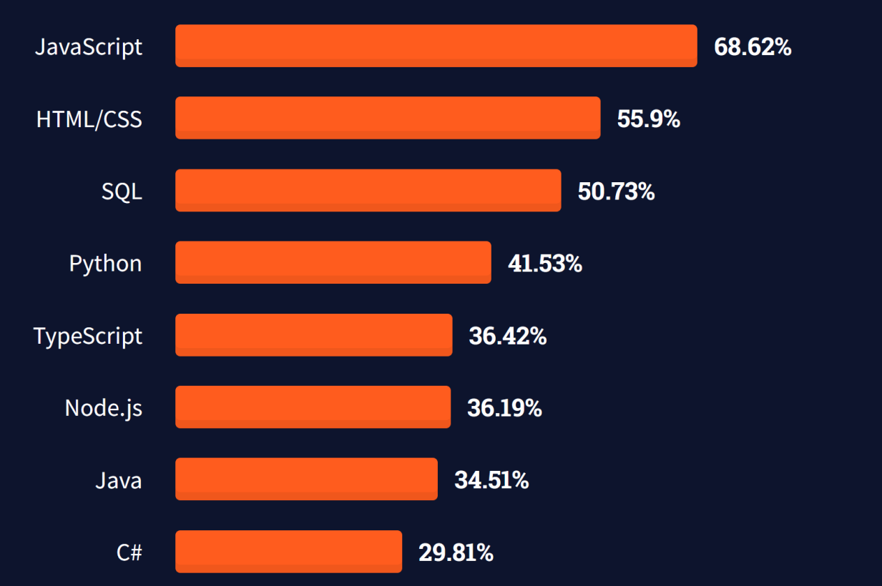
Numbers
https://insights.stackoverflow.com/survey/2021#most-popular-technologies-language-prof

Slide 8
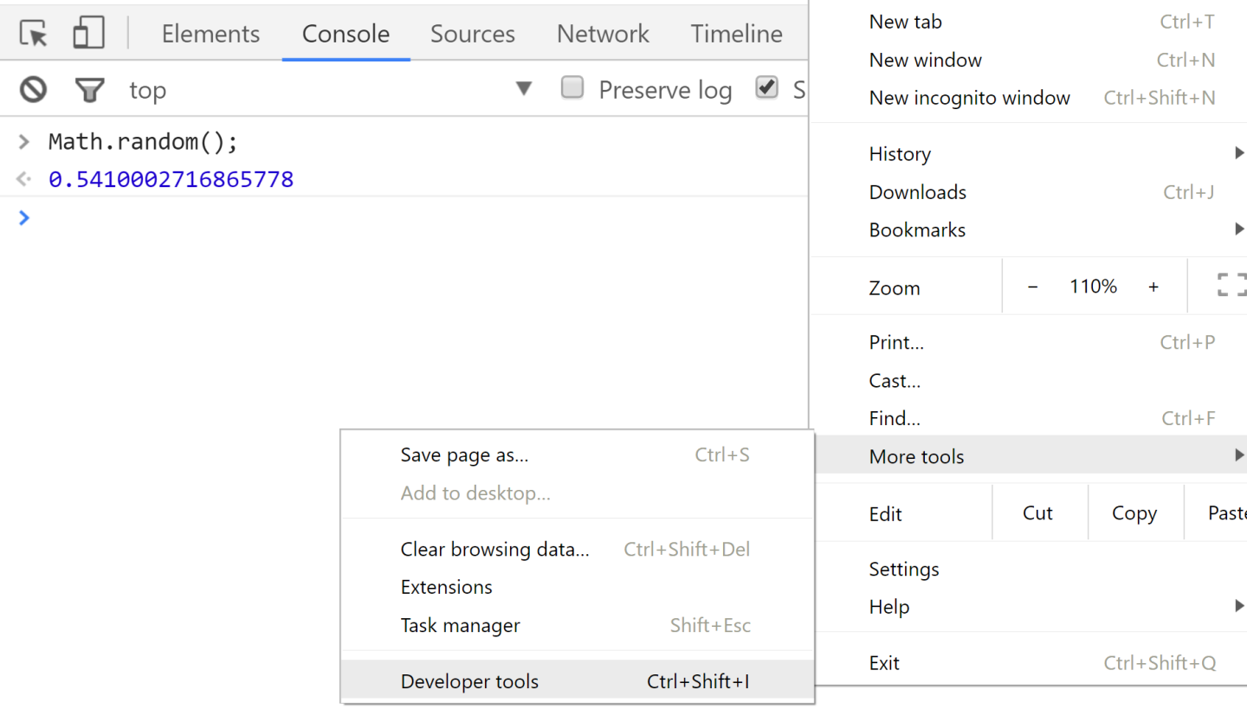
Chrome JavaScript Console

Slide 9
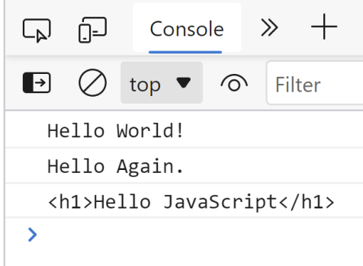
Hello JavaScript
<!doctype html>
<html lang="en">
<head>
<title>Hello JavaScript</title>
<script src="js/script.js"></script>
<script>
console.log("Hello Again.");
</script>
</head>
<body>
<script>
console.log("<h1>Hello JavaScript</h1>");
</script>
</body>
</html>
index.html
var hello = "Hello World!";
console.log(hello);
js/script.js

Slide 10
Literals
A literal is a data value that appears directly in a program.
12 // The number twelve
1.2 // The number one point two
"hello world" // A string of text
'Hi' // Another string
true // A Boolean value
false // The other Boolean value
/\w+\s/g // A "regular expression" literal
// (for pattern matching)
null // Absence of an object
{ x:1, y:2 } // An object initializer
[1,2,3,4,5] // An array initializer

Slide 11
Literals Example
console.log(12);
console.log(1.2);
console.log("hello world");
console.log('Hi');
console.log(true);
console.log(false);
console.log("One or more characters followed by a space: "
+ 'fee fi fo fum'.match(/\w+\s/g));
console.log(null);
console.log({ x:1, y:2 });
console.log([1, 2, 3, 4, 5]);

Slide 12
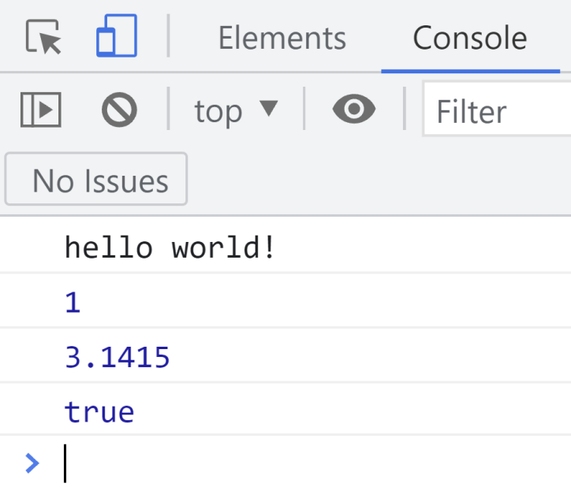
Variables
No types are declared.
Same variable can hold different types during the life of the execution.
// This holds a string
var message = "hello world!";
console.log(message);
// These hold numbers
var count = 1;
console.log(count);
var pi = 3.1415;
console.log(pi);
// This holds a boolean
var isFun = true;
console.log(isFun);
// this is a single-line comment, which runs to the end of the line
var a = 5; // this is a single-line comment following some actual code
/* This is a multiline comment that will run until
we close it. It looks like a CSS comment */

Slide 13
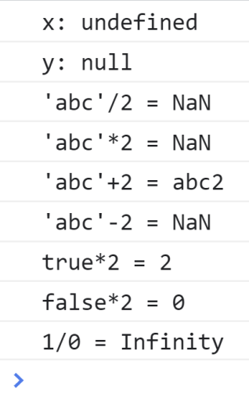
Undefined, null, NaN and Infinity
var x;
console.log("x: " + x);
var y = null;
console.log("y: " + y);
console.log("'abc'/2 = " + 'abc'/2);
console.log("'abc'*2 = " + 'abc'*2);
console.log("'abc'+2 = " + 'abc'+2);
console.log("'abc'-2 = " + ('abc'-2));
console.log("true*2 = " + true*2);
console.log("false*2 = " + true*2);
console.log("1/0 = " + 1/0);
Undefined
uninitialized value
null
deliberate non-value
NaN
not-a-number
Infinity
https://developer.mozilla.org/en-US/docs/Glossary/Type_coercion
Type coercion is the automatic or implicit conversion of values from one data type to another (such as strings to numbers).

Slide 14
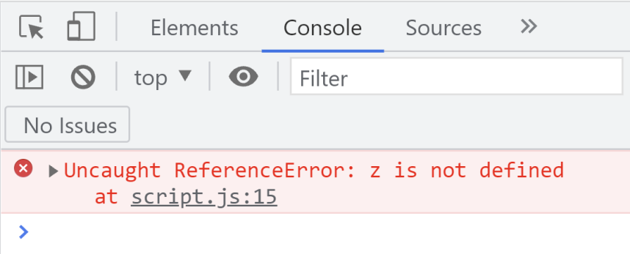
"not defined"
console.log("z: " + z);

Slide 15
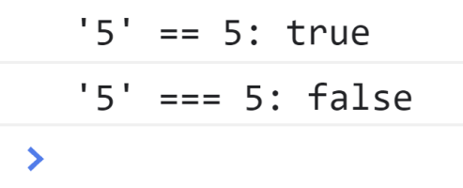
Comparisons
The == comparisons should be used where the type of variable is not your concern;
If the data type of the variables also should be compared, then you should opt for a === comparison symbol.
var string5 = '5';
var number5 = 5;
console.log("'5' == 5: " + (string5 == number5));
console.log("'5' === 5: " + (string5 === number5));

Slide 16


Slide 17
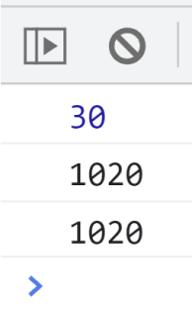
Function Declarations
Function declarations consist of the function keyword, followed by these components:
An identifier that names the function.
A pair of parentheses around a comma-separated list of zero or more identifiers. These identifiers are the parameter names for the function.
A pair of curly braces with zero or more JavaScript statements inside.
function add(a, b) {
return a + b;
}
var sum = add(10, 20); console.log(sum);
sum = add("10", 20); console.log(sum);
sum = add("10", "20"); console.log(sum);

Slide 18
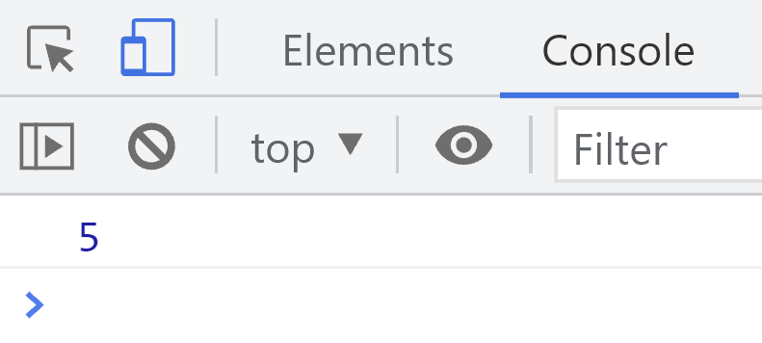
Function Expressions
Function expressions look a lot like function declarations, but they appear within the context of a larger expression or statement, and the name is optional.
// Note that we assign it to a variable
var subtract = function (a, b) {
return a - b;
};
var difference = subtract(10, 5);
console.log(difference);

Slide 19
Function Expressions with Names
Function expressions can include names, which is useful for recursion.
var f = function fact(x) {
if (x <= 1) {
return 1;
}
else {
return x * fact(x - 1);
}
};
var f5 = f(5);
console.log(f5);

Slide 20
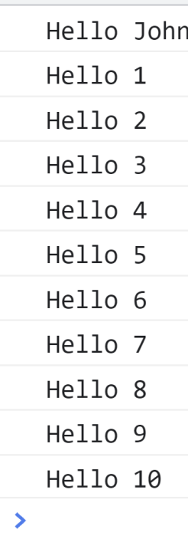
Functions as Parameters
Unlike C++ and Java, functions are first-class citizens.
That means we can assign functions to variables, send in functions as parameters to other functions, or return a function from another function.
// define a function and store it in a variable called sayHello
var sayHello = function (name) {
console.log("Hello " + name);
}
// execute the function in the sayHello variable
sayHello("John");
function repeat10times(action) {
for (var i = 1; i <= 10; i++) {
action(i);
}
}
repeat10times(sayHello);

Slide 21
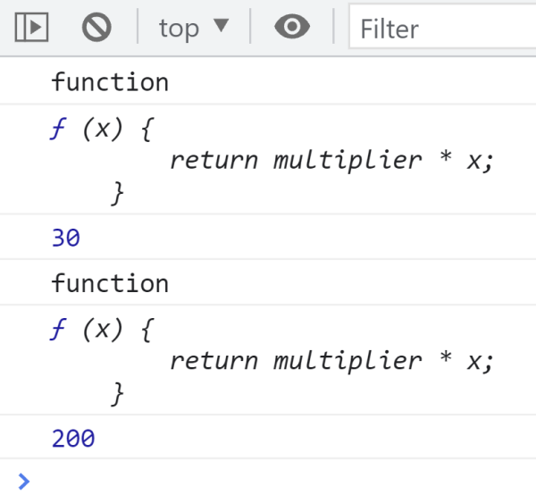
Functions as Return Values
function makeMultiplier(multiplier) {
var returnFunc = function (x) {
return multiplier * x;
};
return returnFunc;
}
var multiplyBy3 = makeMultiplier(3);
console.log(typeof multiplyBy3);
console.log(multiplyBy3);
let result1 = multiplyBy3(10);
console.log(result1);
var doubleAll = makeMultiplier(2);
console.log(typeof doubleAll);
console.log(doubleAll);
let result2 = doubleAll(100);
console.log(result2);

Slide 22
Quiz
What is the output for the following JavaScript code?
function makeMultiplier(multiplier) {
var returnFunc = function (x) {
return multiplier * x;
};
return returnFunc;
}
var operation = makeMultiplier(10);
console.log(operation(5));

Slide 23
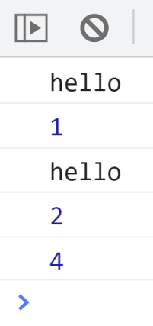
Scope of var
Scope means where these variables are available for use.
var declarations are globally scoped or function scoped.
var hello = "hello";
function varTest(condition) {
console.log(hello);
var x = 1;
if (condition) {
var x = 2; // same variable!
console.log(x);
x = 3;
var x = 4;
}
console.log(x);
} varTest(false);
varTest(true);
var variable can be updated and re-declared in its scope.

Slide 24
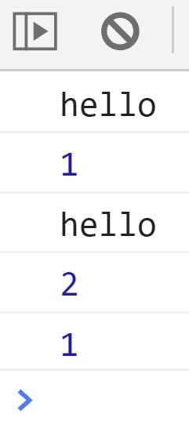
Scope of let
A block is a chunk of code bounded by {}.
let is block scoped.
let hello = "hello";
function letTest(condition) {
console.log(hello);
let x = 1;
if (condition) {
let x = 2; // different variable
console.log(x);
x = 3;
// let x = 4; error
}
console.log(x);
} letTest(false);
letTest(true);
let variable can be updated but not re-declared in its scope.

Slide 25
Scope of const
const is block scoped.
const hello = "hello";
function constTest(condition) {
console.log(hello);
const x = 1;
if (condition) {
const x = 2;
console.log(x);
// x = 3; error
// const x = 4; error
}
console.log(x);
}
constTest(false);
constTest(true);
const variable cannot be updated or re-declared.

Slide 26
Quiz
What are the outputs?
var scope = "global";
function testHoisting() {
console.log(scope);
var scope = "local";
console.log(scope);
}
testHoisting();

Slide 27
Hoisting
JavaScript’s function scope means that all variables declared within a function are visible throughout the body of the function.
Curiously, this means that variables are even visible before they are declared.
This feature of JavaScript is informally known as hoisting: JavaScript code behaves as if all variable declarations in a function (but not any associated assignments) are “hoisted” to the top of the function.
var scope = "global";
function testHoisting() {
console.log(scope); // Prints "undefined", not "global"
var scope = "local"; // Variable initialized here, but defined everywhere
console.log(scope); // Prints "local"
}
testHoisting();
function testHoisting2() {
var scope; // Local variable is declared at the top of the function
console.log(scope); // It exists here, but still has "undefined" value
scope = "local"; // Now we initialize it and give it a value
console.log(scope); // And here it has the value we expect
}
testHoisting2();

Slide 28
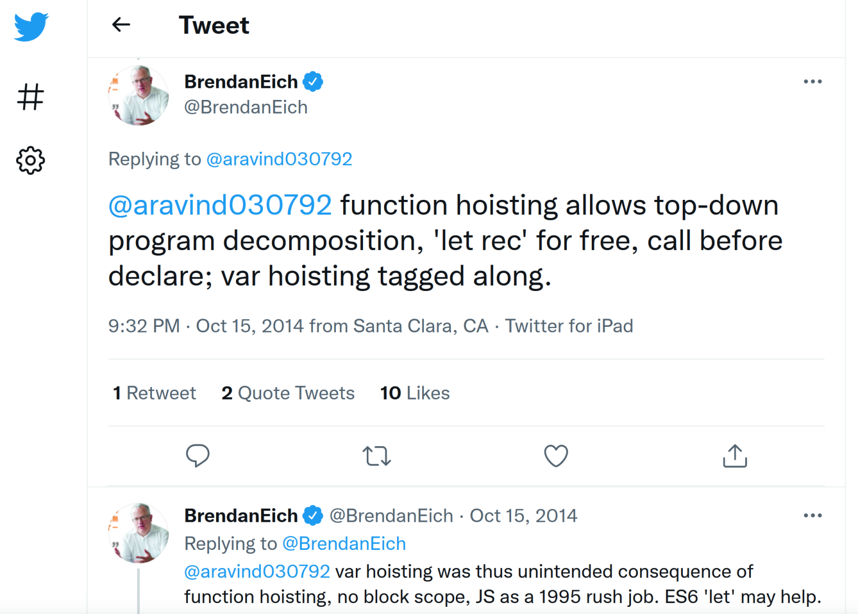
Why Hoisting?
https://twitter.com/BrendanEich/status/522394590301933568
The JS code interpretation performed in two passes. During the first pass, the interpreter processes variable and function declarations.
The second pass is the actual code execution step. The interpreter processes function expressions and undeclared variables.

Slide 29
Rest Parameters
The rest parameter syntax allows a function to accept an indefinite number of arguments as an array.
function sum(...theArgs) {
let total = 0;
for (const arg of theArgs) {
total += arg;
}
return total;
}
console.log(sum(1, 2, 3));
// Expected output: 6
console.log(sum(1, 2, 3, 4));
// Expected output: 10

Slide 31
Object Literals
The easiest way to create an object is to include an object literal in your JavaScript code.
In its simplest form, an object literal is a comma-separated list of colon separated name:value pairs, enclosed within curly braces.
A property name is a JavaScript identifier or a string literal (the empty string is allowed).
A property value is any JavaScript expression; the value of the expression (it may be a primitive value or an object value) becomes the value of the property.

Slide 32
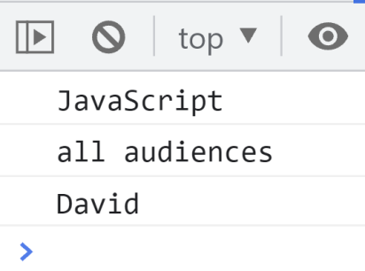
Object Literal Example
let empty = {}; // An object with no properties
let point = { x: 0, y: 0 }; // Two numeric properties
let p2 = { x: point.x, y: point.y + 1 }; // More complex values
let book = {
// These property names include spaces
"main title": "JavaScript",
// and hyphens, so use string literals.
"sub-title": "The Definitive Guide",
for: "all audiences", // for is reserved, but no quotes.
author: { // The value of this property is
firstname: "David", // itself an object.
surname: "Flanagan"
}
};
console.log(book["main title"]);
console.log(book.for);
console.log(book.author.firstname);

Slide 33
Curly Brackets
function printName1()
{
return
{
name: "Bien Ngo"
};
}
function printName2() {
return {
name: "Bien Ngo"
};
}
console.log(printName1());
console.log(printName2());
What are the outputs?

Slide 34
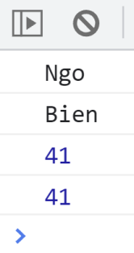
Add Properties to Object
var person = {};
person.firstName = 'Ngo'; // add property via dot operator
person.lastName = 'Bien'; // add property via dot operator
person["age"] = 41; // add property via square brackets
console.log(person.firstName);
console.log(person.lastName);
console.log(person.age);
console.log(person["age"]);

Slide 35
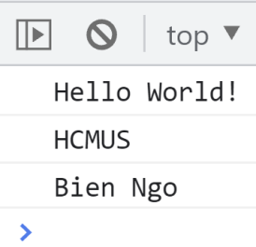
Add Functions (Methods) to Object
var person = { sayHello: function() { // method
console.log("Hello World!");
},
getOrganization: function() {
return "HCMUS";
}
};
person.getFullName = function () { // method
return "Bien Ngo";
};
person.sayHello();
console.log(person.getOrganization());
console.log(person.getFullName());

Slide 36
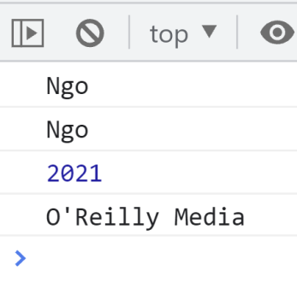
Property Shorthand
The variable value is implicitly assigned to object property and there is no need to have a property specified while declaring an object.
let author = "Ngo";
let book = { author };
console.log(book.author);
let year = 2021;
let publisher = "O'Reilly Media";
let book2 = { publisher, year, author };
console.log(book2.author);
console.log(book2.year);
console.log(book2.publisher);

Slide 37
Template Literals
Template literal is a concatenation of variable in string without using any operator, such as +.
Template literals are enclosed by the back-tick (` `) (grave accent) instead of double or single quotes.
let publisher = "O'Reilly Media";
let edition = 3;
let es6 = "ECMAScript 2015 (also known as ES6 and ECMAScript 6)";
let book = { publisher,
[`What's new in edition ${edition}?`] :
`${es6} and other improvisation.`
};
console.log(`Whats new in edition ${edition}?`);
console.log(book[`What's new in edition ${edition}?`]);
Computed property name: put an expression in brackets [], that will be computed and used as the property name

Slide 38
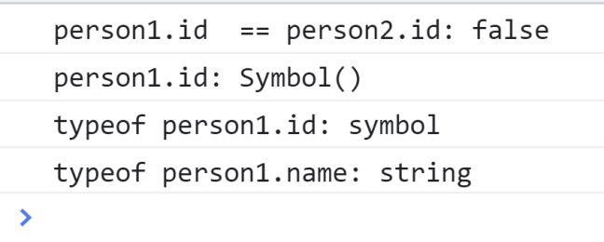
Symbol
A Symbol value represents a unique identifier.
To obtain a Symbol value, you call the Symbol() function.
This function never returns the same value twice, even when called with the same argument.
let person1 = {};
person1.id = Symbol();
person1.name = "Ngo Huy Bien";
let person2 = {};
person2.id = Symbol();
person2.name = "Bien Huy Ngo"; console.log("person1.id == person2.id: " +
(person1.id == person2.id));
console.log("person1.id: " + person1.id.toString());
console.log("typeof person1.id: " + typeof person1.id);
console.log("typeof person1.name: " + typeof person1.name);

Slide 39
Primitive Data Types
https://developer.mozilla.org/en-US/docs/Glossary/Primitive
A primitive (primitive value, primitive data type) is data that is not an object and has no methods.
There are 7 primitive data types: string, number, bigint, boolean, undefined, symbol, and null.
All primitives are immutable, i.e., they cannot be altered.
It is important not to confuse a primitive itself with a variable assigned a primitive value.
The variable may be reassigned a new value, but the existing value can not be changed in the ways that objects, arrays, and functions can be altered.
let string = "Ngo Huy Bien";
string = "Bien Huy Ngo";
// "Bien Huy Ngo" = "Ngo";

Slide 40
Primitive Wrapper Objects
Except for null and undefined, all primitive values have object equivalents that wrap around the primitive values:
String for the string primitive.
Number for the number primitive.
BigInt for the bigint primitive.
Boolean for the boolean primitive.
Symbol for the symbol primitive.
The wrapper's valueOf() method returns the primitive value.
let bigInteger = BigInt(12345678901234567890);
console.log("bigInteger: " + bigInteger.valueOf());

Slide 41
Boolean
// ***** If statement (all false)
if ( false || null || undefined || "" || 0 || NaN) {
console.log("This line won't ever execute");
}
else {
console.log ("All false");
}
// ***** If statement (all true)
if (true && "hello" && 1 && -1 && "false") {
console.log("All true");
}
else {
console.log ("One of them is true.");
}
What are the outputs?
Boolean can only have 2
values: true or false.

Slide 42
String
let firstName = "Bien";
let fullName = firstName + " Ngo";
console.log("Full Name: " + fullName);
let coercion1 = false && fullName;
console.log("false && string: " + coercion1);
console.log("Type: " + (typeof coercion1));
let coercion2 = false || fullName;
console.log("false || string: " + coercion2);
console.log("Type: " + (typeof coercion2));
let coercion3 = true && fullName;
console.log("true && string: " + coercion3);
console.log("Type: " + (typeof coercion3));
let coercion4 = true || fullName;
console.log("true || string: " + coercion4);
console.log("Type: " + (typeof coercion4));
What are the outputs?
String is sequence of characters used to represent text.

Slide 43
Handling Default Values
function orderChickenWith(sideDish) {
console.log("Chicken with " + sideDish);
}
orderChickenWith("noodles");
orderChickenWith();
function orderChickenWith2(sideDish) {
if (sideDish == undefined) {
sideDish = "whatever!";
}
console.log("Chicken with " + sideDish);
}
orderChickenWith2("noodles");
orderChickenWith2();

Slide 44
Idiom for Handling Default Values
function orderChickenWith3(sideDish) {
sideDish = sideDish || "whatever!";
console.log("Chicken with " + sideDish);
}
orderChickenWith3("noodles");
orderChickenWith3();
Why care about this idiom?

Slide 45
for
// for loop
var sum = 0;
for (var count = 0; count < 10; count++) {
sum = sum + count;
console.log("Count: "+ count + ". Sum: " + sum);
}
console.log("Sum of 0 through 9 is: " + sum);
var x = 10;
if ( (null) || (undefined ) || ("")
|| (console.log("Hello")) || x > 5 ) {
console.log("Hello");
}
How many times will the word 'Hello' be printed to the console?

Slide 46
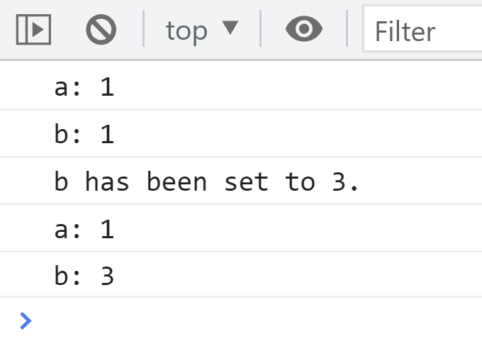
Copy by Value
In JavaScript, primitives are copied by value.
var a = 1;
var b = a;
console.log("a: " + a);
console.log("b: " + b);
b = 3;
console.log("b has been set to 3.");
console.log("a: " + a);
console.log("b: " + b);
a
b
1
1
1
3

Slide 47
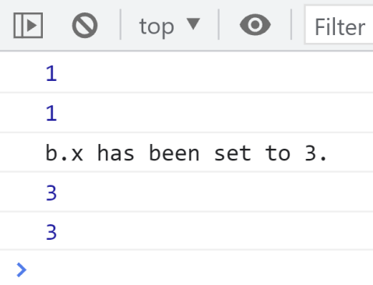
Copy by Reference
Also called copy by address.
In JavaScript, objects are copied by reference.
var a = { x: 1 };
var b = a;
console.log(a.x);
console.log(b.x);
b.x = 3;
console.log("b.x has been set to 3.");
console.log(a.x);
console.log(b.x);
a
a
b
b
1
3

Slide 48
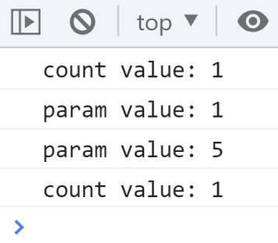
Pass by Value
In JavaScript, primitives are passed by value.
function passByValue(param) {
console.log("param value: " + param);
param = 5;
console.log("param value: " + param);
}
var count = 1;
console.log("count value: " + count);
passByValue(count);
console.log("count value: " + count);

Slide 49
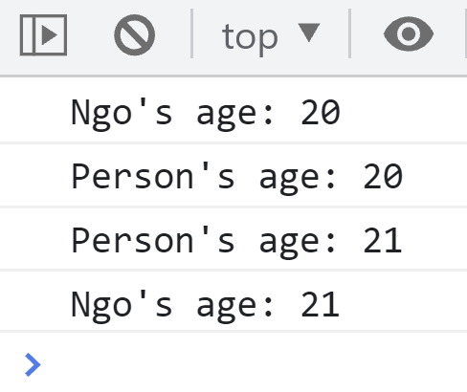
Pass by Reference
Also called passed by address.
In JavaScript, objects are passed by reference.
function passByReference(person) {
console.log("Person age: " + person.age);
person.age = 21;
console.log("Person age: " + person.age);
}
var ngo = { age: 20 };
console.log(ngo.age);
passByReference(ngo);
console.log(ngo.age);

Slide 50

Further Reading
https://developer.mozilla.org/en-US/docs/Learn/JavaScript
Jon Duckett (2014). JavaScript and JQuery. Interactive Front-End Web Development. John Wiley & Sons: from Chapter 1 to Chapter 4.
Marijn Haverbeke (2019). Eloquent JavaScript - A Modern Introduction to Programming. No Starch Press: from Chapter 1 to Chapter 5.
Kyle Simpson (2020). You Don't Know JS Yet - Get Started. Leanpub.
Kyle Simpson (2020). You Don't Know JS Yet - Scope & Closures. Leanpub.
Kyle Simpson (2015). You Don't Know JS - Types & Grammar. O'Reilly Media.

Slide 51

Thank You & See You Again

